Slide 1

Unit 3

Slide 2

Group
A “group” is defined as two or more individuals, interacting and interdependent, who come together to achieve particular objectives.

Slide 3
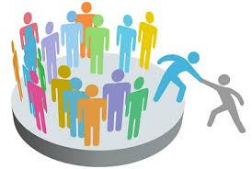
Type of Group
Formal
Informal

Slide 4
KEY GROUP CONCEPTS
Roles
Status
Norms

Slide 5
GROUP COHESIVENESS
Time spent together
Shared values
Group Size
Behavior management
Management behavior

Slide 6

Leigh Thompson of the Kellogg School of Management
"Team Is A Group Of People Who Are Interdependent With Respect To Information, Resources, And Skills And Who Seek To Combine Their Efforts to Achieve a Common Goal"

Slide 7

Types of Teams
Problem-solving teams
Self-managed work teams
Cross-functional teams
Virtual teams

Slide 8
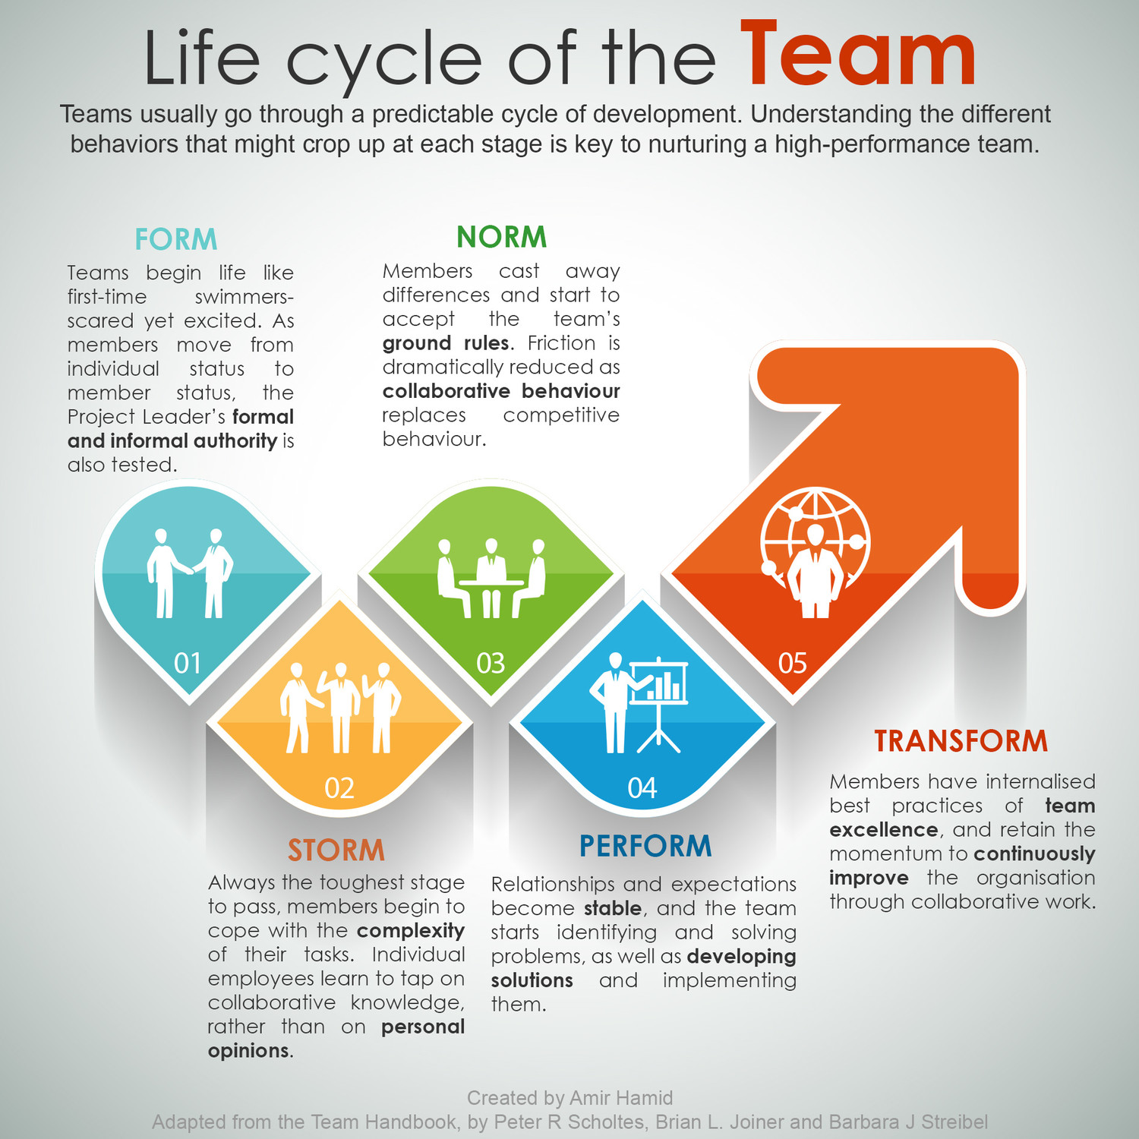

Slide 9
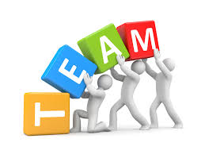
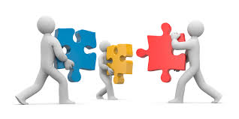

INGREDIENTS OF EFFECTIVE TEAMS
Supportive Environment
Skills and Role Clarity
Super-ordinate Goals
Team Rewards

Slide 10
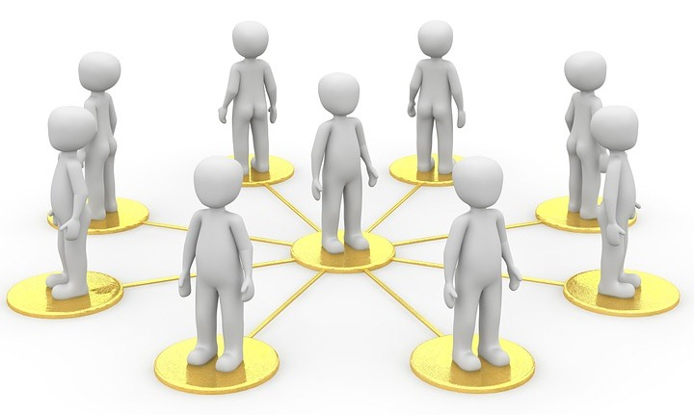
Turning Individuals Into Team Players
Selection
Training
Rewards

Slide 11
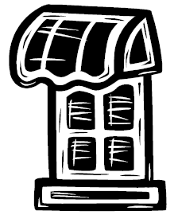

“A model for self- awareness, personal development, group development and understanding relationship”.
Johari Window

Slide 12

The Johari Window model
Developed by American psychologists Joseph Luft and Harry Ingham in the 1950's, calling it 'Johari' after combining their first names, Joe and Harry

Slide 13
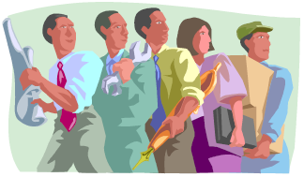

Terminology
Refers to 'self' and 'others‘
'Others' - other people in the team
‘Self' - oneself, i.e., the person
subject to the Johari Window
analysis
Notes:
‘Self' - oneself, i.e., the person
subject to the Johari Window
analysis

Slide 14
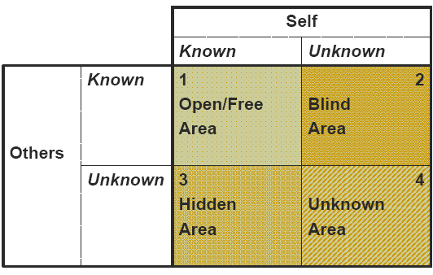
Standard Representation

Slide 15
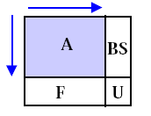

IDEAL WINDOW
Arena increases as level of trust increases and as people’s thoughts, feelings & desires as well as actions are made available to other group members.

Slide 16
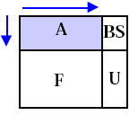

INTERVIEWER
Asks questions of others but does not commit to where he stands on issues.

Slide 17

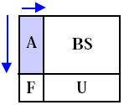
BULL-IN-CHINA-SHOP
Tells others what he thinks of them, how he feels about what is happening in the group & where he stands on issues, but is insensitive to or ignores feedback given to him.

Slide 18

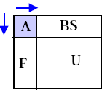
TURTLE
Neither solicits nor gives feedback, thus insulates himself from the group and remains a mystery person to the group.

Slide 19

TRANSATIONAL ANALYSIS

Slide 20
TRANSATIONAL ANALYSIS
Valuable approach to understand human behavior & action.
Developed by Dr. Eric Brene.
Point of theory- When two people encounter each other ,one of them speak to the other. This is called Transactional Stimulus. The reaction from the other person is called the Transactional Response.

Slide 21
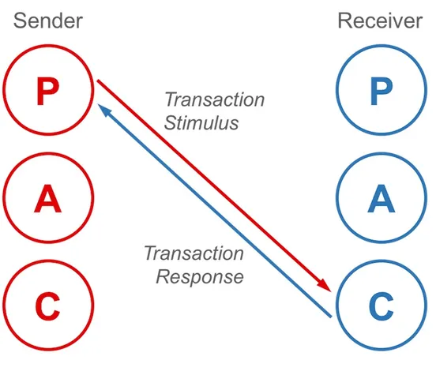
INDIVIDUAL PERSONALITY
Transactional analysis divides an individual’s personality into 3 ego states

Slide 22
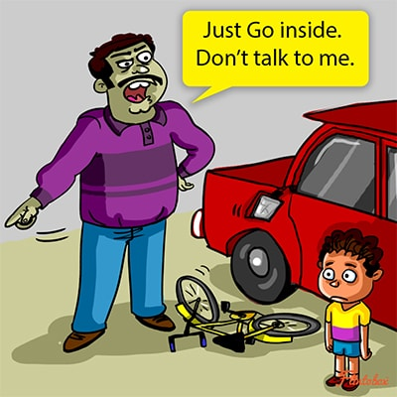
PARENT EGO STATE
Our ingrained voice of authority, absorbed conditioning, learning and attitude from when we were young.
Typically embodied by phrases and attitudes starting with ‘how to’, ‘under no circumstances’, ‘always’, ‘never forget’, ‘don’t lie’, ‘cheat’ and, ‘steal’ etc.
We can change it, but this is easier said than done.

Slide 23

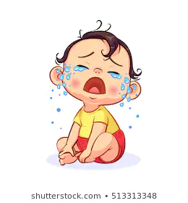
CHILD EGO STATE
Our internal reaction and feeling to external events form the ‘child’.
This is the seeing, hearing, feeling and emotional body of data within each of us.
When anger or despair dominates reason, the child is in control.
Like our parent we can change it, but it is no easier.

Slide 24

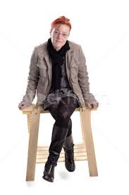
ADULT EGO STATE
Our ‘Adult’ is our ability to think and determine action for ourselves, based on received data.
If we are to change our Parent or Child we must do so through our adults.

Slide 25
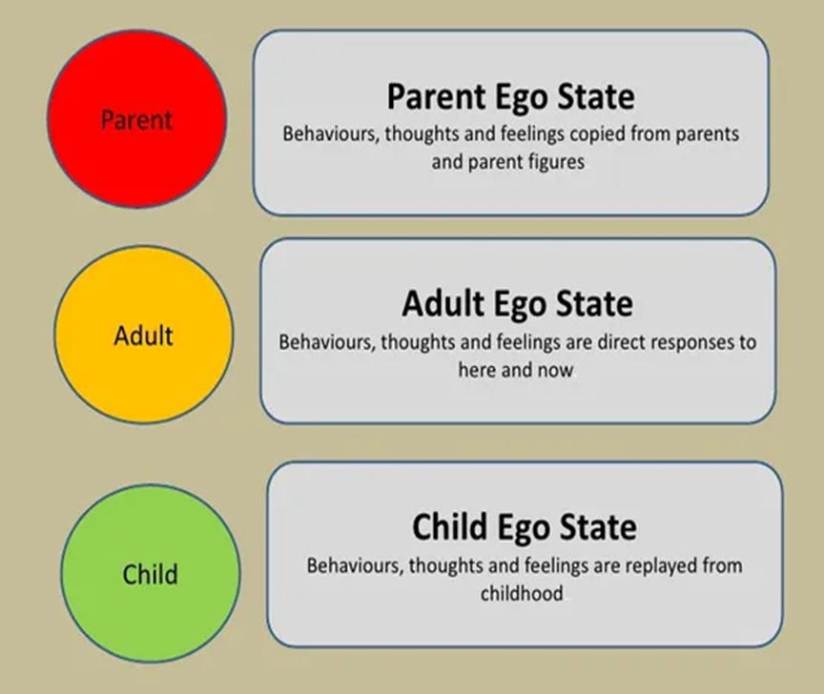
Parents are our ‘Taught’ concept of life.
Adults is our ‘Thought’ concept of life.
Child is our ‘Felt’ concept of life.

Slide 26
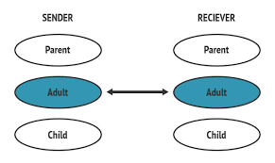
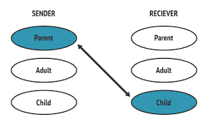
BERNE’S THEORY
Effective transaction must be complementary. They must go back from the receiving ego state to the sending ego state.
If a crossed transaction occurs there is an ineffective communication.

Slide 27
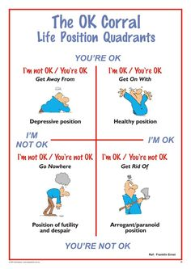
LIFE POSITIONS
Life positions are basic beliefs about self and others, which are used to justify decisions and behavior.
I am Not OK, You are OK One Down Position | I am OK, You are OK Healthy Position
I am Not OK, You are Not OK Hopeless Position | I am OK, You are Not OK One Up Position

Slide 28
Knowledge of human behaviors and of transaction types helps to enhance the communication skills of a Leader.

